Slide 1
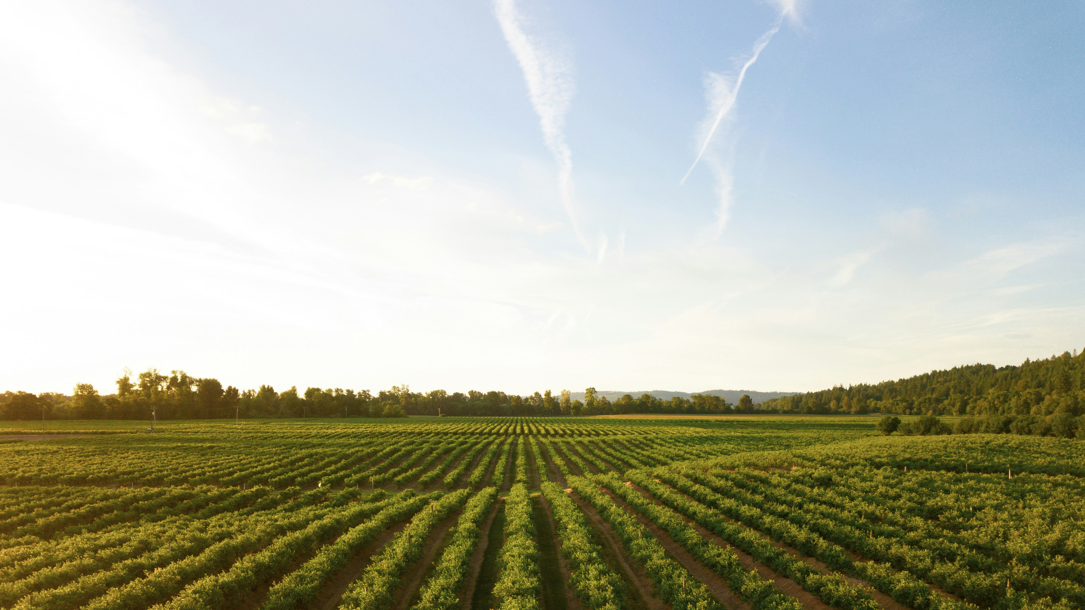
Affect of Community Growth on Surrounding Agriculture
COUNTY
County_ID (PK)
State
FARM SIZE
FarmSize_ID (PK)
County_ID (FK)
< 100
101-500
501 – 1000
>1000
Year
OWNERSHIP
Ownership_ID (PK)
County_ID (FK)
Owners
Partial Owners
Tenants
Year
POPULATION
Population_ID (PK)
County_ID (FK)
Population_size
Year

